Slide 1
GROUP 16
MEMBERS
Asante Owuraku
Asante Gyan Maame Konadu
Asante-Duah Emmanuel
Asare Doris Durowaa
Asenso Daniel Mensah
Ashun Rodney Afosah
Asiama-Kumi Nhyira Damptey
Asibu Frank
Asotia-Boakye Kwabena Kwarteng
Assah Nana Kofi Konadu
Daud Nagila Sienu

Slide 2
TABLE OF CONTENT
PROBLEM STATEMENT
METHODOLOGY
CHALLENGES ENCOUNTERED
POSSIBLE IMPPROVEMENTS

Slide 3
PROBLEM STATEMENT
Noise pollution refers to excessive or disturbing sound levels that negatively affect human health, wildlife, and the environment.
This project seeks to design an IoT-based noise pollution monitor that tracks noise levels and alerts when limits are exceeded.

Slide 4
METHODOLOGY
OBJECTIVE: We developed a system to track noise levels and send alerts when limits are exceeded.
HARDWARE: ESP32 was used to achieve this goal.
SOFTWARE AND CONNECTIVITY: It was programmed in Arduino C, connected to an IoT platform, Blynk, with real-time data logging and mobile notifications
IMPLEMENTATION: The sensor collects noise data, the microcontroller processes it, and alerts are sent when thresholds are exceeded. Data is visualized on dashboards in Blynk .
Solutions to noise pollution: Public awareness, noise barriers, regulatory enforcement, urban planning, and smart traffic management will help reduce noise pollution.

Slide 5
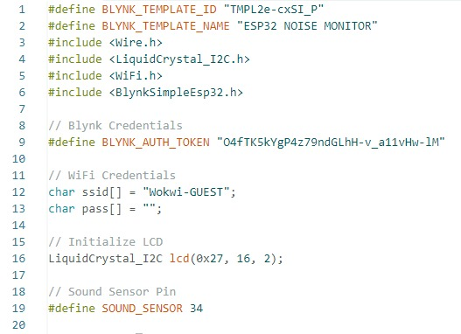
OVERVIEW OF CODE:

Slide 6
This section of the code is where libraries needed for the program to run are
defined.
Also parameteers neede to properly run Blynk are also stated in this section of the code
Also we specify our network ssid and password in this section of the code
The LCD parameters for the I2C protocol are also given here
We also define the pin on the ESP32 that will receive analog data from the sensor.

Slide 7
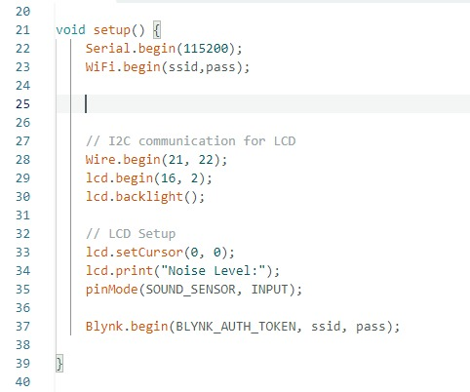

Slide 8
This portion of the code is where we write our setup code
First we begin serial communication and set our baud rate.Then we initialize WiFi connectivity on the ESP32 with our SSID and password
The next portion is where we set up begin I2C communication with the LCD and also initialize it.The cursor position is defined and then the output on the LCD screen is also given.
Pin 34(sensor pin) is then assigned as an input
The next thing is to authenticateand establish our connection with Blynk using our assigned authorization token, ssid and network password .

Slide 9
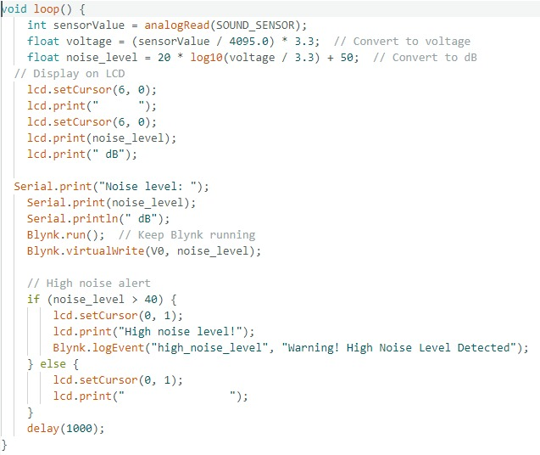

Slide 10
Now this portion is our loop code.This is where the major functions of that we need are going to be placed.
First we assign a variable to the analog input of the sensor.We then convert that number to a voltage and afterwards change it to a decibel value
We now add some extra code to display the output on the LCD.The LCD is periodically cleared to be able to display real-time data.
We then make sure to keep Blynk runnning and also stream our data to their cloud sever using a predefined virtual pin V0.
The if statement then triggers two actions at a reading greater than 40dB:
Displaying a warning message on the LCD and then sending a message to the Blynk service to notify the user
The function is then delayed for 1 second to avoid continiuos running of the void loop

Slide 11
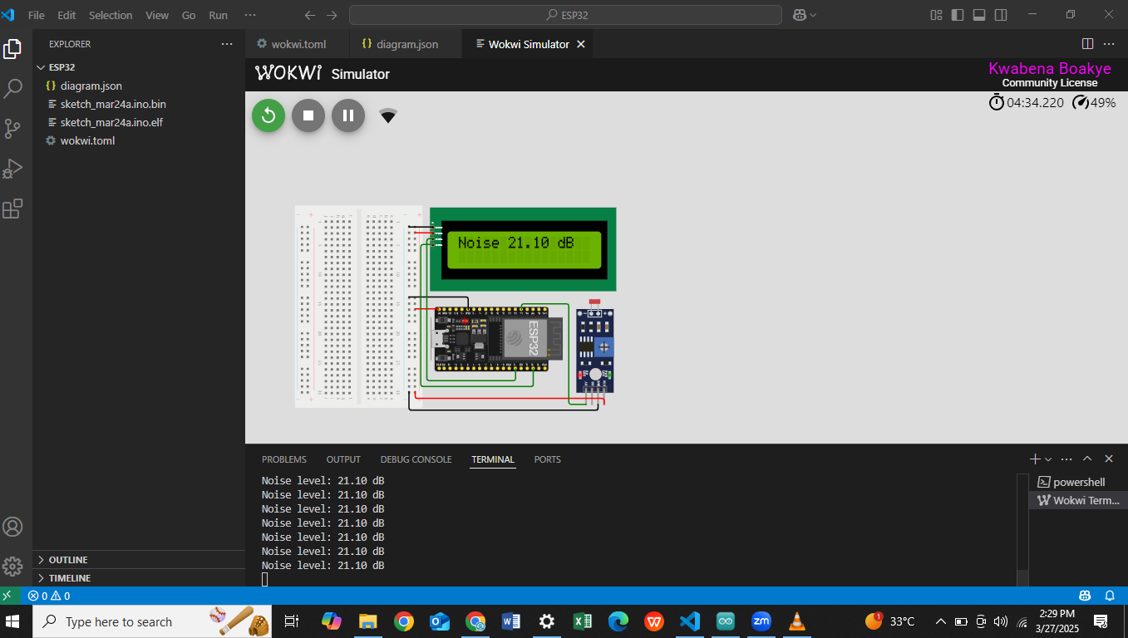
SCHEMATIC DIAGRAM

Slide 12
The ESP32 is a microcontroller with built-in WiFi and Bluetooth capabilities, making it ideal for IoT applications. It features multiple ADC (Analog-to-Digital Converter) pins, allowing it to read analog sensor data . In this project, it serves as the core processing unit, handling sensor data, displaying results on an LCD, and transmitting noise level readings to the Blynk IoT platform.
The I2C LCD module is a display unit used for real-time data visualization. Unlike traditional LCDs that require multiple digital pins for communication, this module uses the I2C protocol, reducing wiring complexity and making it easier to interface with the microcontroller .The LCD displays measured noise levels in decibels (dB), allowing users to view real-time readings directly from the device. The LiquidCrystal_I2C library is used to control the display, enabling smooth and efficient updates.It is connected to pins 21(SDA) and 22(SCL)

Slide 13
The LDR module although traditionally used to detect light intensity was used in this project to stand in as a sound sensor.This is because the output of the LDR module is analogous to that of a sound sensor and as such provides an appropriate model of a sound sensor.

Slide 14
IOT INTEGRATION
Blynk IoT is a cloud-based platform that enables remote monitoring and control of IoT devices via a mobile application. It provides an interface for visualizing real-time sensor data, setting up alerts, and logging historical data. In this project, the ESP32 transmits noise level readings to the Blynk cloud, allowing users to monitor noise levels remotely from their smartphones. Additionally, Blynk was configured to send notifications if noise levels exceed a predefined threshold, making it a useful tool for real-time monitoring and alerts.

Slide 15
CHALlenges encountered
For this project the main issues were mainly software limitations of the tools that were available.An obvious one was our inability too use an actual sound sensor but rather a substitute to model its output to enable us the test our solution.
Also,during testing we encountered the fact connecting to the Blynk iot service required a good internet connection.As such poor network services could cause issues.

Slide 16
Furthermore,the inability of the device to connect to the Blynk causes the code to loop at that point resulting in the rest of the code not being able to run.
As such limited interet connectivity hampers the functionality of the system.

Slide 17
Possible IMprovement
First and foremost the ability to use an actual sound sensor would be greatly beneficial to properly test the system especially if it is intended to be physically implemented.
Another improvement would also be to allow the user to set their own noise limits instead of the limits being hardcoded.
Finally allowing local connection to user devices,although would still be limiting since the user cannot be remotely monitoring the system,would still be good improvement since it would still provide some level of remote monitoring although within a short range

